Slide 1

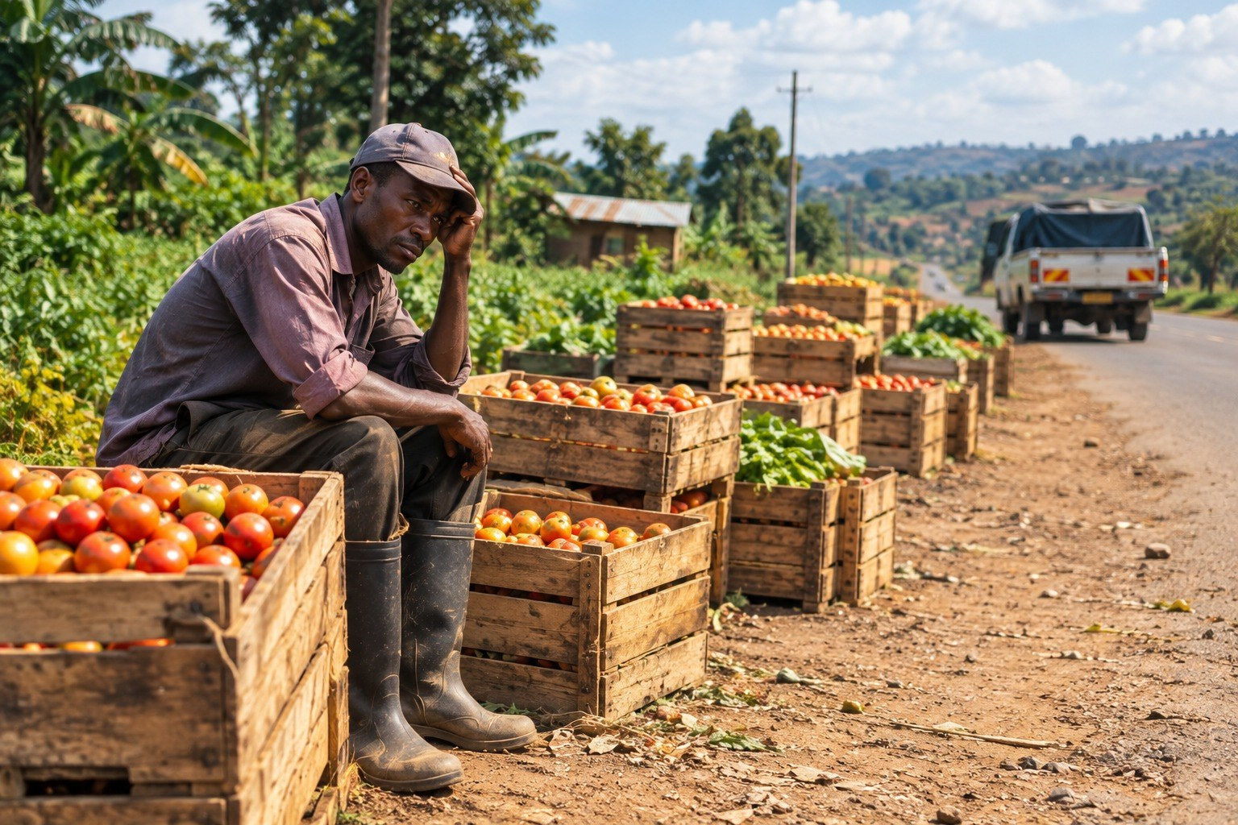
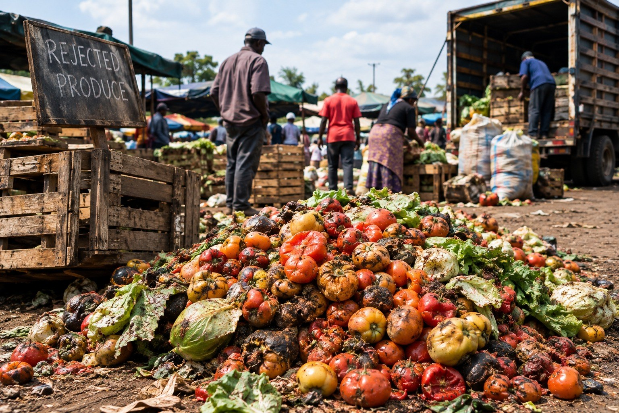
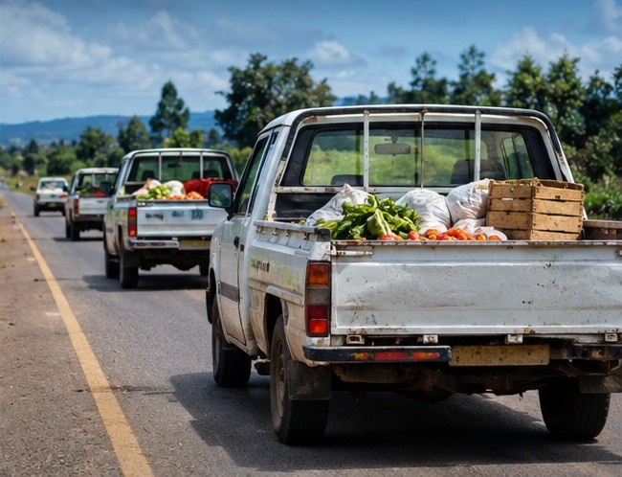
Sell before you harvest.
HarvestLink
The problem, on the ground
by Bora Chakula
GREEN TECH HACKATHON 2026
No buyer at harvest. Crates waiting by the road.
Lower grades wasted. Rejected produce dumped at market.
One trip per farmer. Half-empty pickups on one road.
Buyers post what they need weeks before harvest. We combine smallholder farms to fill each order, find a buyer for every grade and send one truck instead of many.
Team Bora Chakula
John Mwangi Kagunda
Team leader · Backend and database
Faiza Ibrahim Suraw
Product manager · Pitch builder
TRACK
John Maina Ndirangu
Backend and database
5 · Water Stewardship and Climate-Smart Agriculture
David Calvin Chuma
Front-end
Secondary: 4 · Sustainable Transport and Logistics
SherylAnn Nyawira
Design and front-end
INSTITUTION
Murang’a University of Technology
Notes:
Time: 0:45. Speaker: Faiza (product manager) or John (team leader). HOOK (point at the three photos): “A farmer in Kirinyaga plants tomatoes without knowing who will buy them. At harvest, she sells to whoever comes to the farm gate, the smaller tomatoes go to waste, and she pays for her own pickup — so does her neighbour, on the same road.” WHO WE ARE: “We are Team Bora Chakula from Murang’a University of Technology, and this is HarvestLink. John Mwangi leads the team and the database work with John Maina; Faiza is our product manager; David and SherylAnn built the front end and the design. We’re entering Track 5, Water Stewardship and Climate-Smart Agriculture, with Sustainable Transport and Logistics as our second track.” WHAT IT IS: “HarvestLink flips the order: sell before you harvest. Buyers post what they need weeks ahead; we combine small farms to fill each order, find a buyer for every grade, and send one truck instead of many. It runs on Oracle APEX and Autonomous Database on OCI.” Transition: “Let’s look at why this matters.” → Slide 2. The three photos are illustrative; if a judge asks, say so.

Slide 2
Kenyan smallholders grow first and look for a buyer at harvest.
PROBLEM STATEMENT
The challenge
WHY IT MATTERS
Without a buyer lined up, farmers take the farm-gate broker’s price, lower grades go unsold, and each farmer pays for a separate trip.
28%
Who is affected
Smallholder farmers lose income. Grocers, schools and processors cannot get steady volume from any single small farm.
of tomato value is lost between the farm and the point of sale.
Source: IFPRI 2022, post-harvest loss study, Laikipia County.
Who can act
Buyers willing to commit before harvest, cooperatives and field agents who group farmers, and county agriculture offices.
HarvestLink · Team Bora Chakula
2 / 5
Notes:
Time: 1:00. ONE SENTENCE: “Kenyan smallholders grow first and look for a buyer at harvest.” WHAT HAPPENS THEN: “With no buyer lined up, the farmer takes whatever the broker at the farm gate offers. The smaller or marked produce — Grade B and C — often has no buyer at all. And every farmer hires a separate pickup down the same road.” WHY IT MATTERS (point at the number): “A 2022 IFPRI study in Laikipia found about 28% of tomato value is lost between the farm and the point of sale. That is income the farmer never sees and food that never reaches a plate.” WHO: “Farmers lose income, and buyers — grocers, schools, processors — can’t get reliable volume from one small farm. The people who can change this are buyers willing to commit early, and the cooperatives and field agents who already group farmers.” Transition: “So we asked: what if the buyer came first?” → Slide 3. If asked about the source: Gatere, Hoffmann, Murphy and Scollard, “Post-harvest Losses and Food Safety in Tomatoes Produced in Laikipia County”, IFPRI 2022: 28.2% of value lost farmer to point of sale. It is one county and one crop; we use it as our baseline loss rate and say so.

Slide 3

How one order moves through Oracle
SOLUTION AND APPROACH
Scan for the live app
Browser
APEX + ORDS
PL/SQL engine
Tables and views
Blockchain table
Buyer, farmer, agent
Pages and forms
Matching, Select AI
Demands, matches
Agreement ledger
1 · Buyer posts a demand
2 · create_demand()
3 · Save → auto-match runs
4 · Rank, combine, save reasons
5 · Matches + reasons on screen
6 · Farmer confirms 650 kg
7 · Accepted → sealed ledger row
Inside one Oracle Autonomous AI Database 26ai on OCI
HarvestLink · Team Bora Chakula
3 / 5
Notes:
Time: 1:00 on the slide (click through 7 steps), then 2:30 live demo. Present from the browser so the animation plays. OPENING (before clicking): “HarvestLink flips the order: the buyer comes first. Here is how one order moves through our Oracle stack. Everything right of the browser runs inside one Autonomous AI Database on OCI — the app, the logic and the data live together.” CLICK 1: “A buyer — Kijani Fresh Grocers — posts 2 tonnes of Grade A tomatoes in an Oracle APEX form, served by ORDS.” CLICK 2: “The page doesn’t write to tables directly. It calls our PL/SQL API, create_demand, which checks the rules: quantity, delivery date, price.” CLICK 3: “The demand is saved, and a database trigger re-runs matching automatically. No ‘run matching’ button.” CLICK 4: “Our engine ranks every farm on grade, harvest window, quantity and distance, combines farms until the order is full, and saves a plain-language reason for each match.” CLICK 5: “The buyer sees the matches and the reasons — read from views, so every number on screen comes from a query. Select AI can reword the reasons in English or Kiswahili.” CLICK 6: “A farmer — or a field agent for farmers without smartphones — confirms 650 kilograms.” CLICK 7: “The match becomes Accepted, and a trigger writes the agreed terms to an Oracle blockchain table: append-only, SHA2-512 hash-chained. Nobody can edit it, not even us.” LINK: “You can scan the code to open the live app; the judge login is in our submission. Let me show you.” → switch to the browser. DEMO SCRIPT (2:30) — run begin hl_demo.reset; end; before presenting and open the app the day before (Always Free databases stop after 7 days idle): 1. Buyer view: the 2 t Grade A tomato demand. (0:20) 2. Matches: four Kirinyaga farms cover 1,900 kg (95%); read one match’s reasons; Joseph Mugo is not matched because his harvest starts too late. (0:45) 3. Farmer view: confirm an offer; the fulfilment bar moves. (0:25) 4. Route by grade: 640 kg Grade B and 310 kg Grade C go to other outlets. (0:25) 5. Logistics map and impact page: one shared route, km and CO₂ saved, each figure tagged live, simulated or demo. (0:35) Back up: a recorded 3-minute walkthrough in case the venue network fails. If a judge asks for the code: github.com/Byte-Barn/BoraChakula (db/02_match_pkg.sql is the engine, db/06_agreements.sql the ledger).

Slide 4
Demand first, every grade sold, one truck.
INNOVATION AND IMPACT
What makes it different
Green outcomes we measure
 | Today | HarvestLink
Price agreed | At harvest, by the broker | Weeks before, by the buyer
Large orders | One farm cannot fill them | Several farms combined
Lower grades | Often dumped | Routed to markets and processors
Transport | One pickup per farmer | One shared route
The deal | A verbal promise | A tamper-evident record
Produce sold before harvest
kg matched to a buyer. Live from records.
Food loss avoided
kg matched × 28% baseline loss (IFPRI 2022). Estimated.
Km and CO₂ saved
Separate trips vs one route, Kenyan fleet factors (GIZ 2018). Simulated distances.
How we will validate it
Pilot with real deliveries: compare kg sold, waste and trip records against farmers who sell to brokers.
HarvestLink · Team Bora Chakula
4 / 5
Notes:
Time: 1:15. WHAT’S UNIQUE (walk the table, left to right): “Today the price is set at harvest by whoever shows up. With HarvestLink it’s agreed weeks before, by a buyer who needs the produce. One small farm can’t fill a 2-tonne order; we combine several. Lower grades usually get dumped; we route them to markets, schools and processors. Instead of one pickup per farmer, there’s one shared route. And the deal isn’t a verbal promise — it’s written to a ledger nobody can edit, not even us.” Also worth saying: the matching runs inside the database as PL/SQL, so every number on screen comes from a query a judge can inspect, and every match explains itself in plain language. GREEN ECONOMY OUTCOMES: “We track three outcomes. Produce sold before harvest — counted live from the records. Food loss avoided — the matched kilograms times the 28% baseline loss from the IFPRI study. And kilometres and CO₂ saved — separate pickup trips compared with one shared route, using Kenyan fleet emission factors from GIZ: 216 grams of CO₂ per km for a pickup, 760 for a truck. Our road distances are simulated for now — straight-line distance times 1.3 — and the app labels them that way.” VALIDATION: “To prove it, we’ll run a pilot with real deliveries and compare kilograms sold, waste and trip records against farmers who keep selling to brokers.” If asked about the numbers: every impact figure in the app carries a tag — live, simulated or demo — and a ‘how this is calculated’ note.

Slide 5
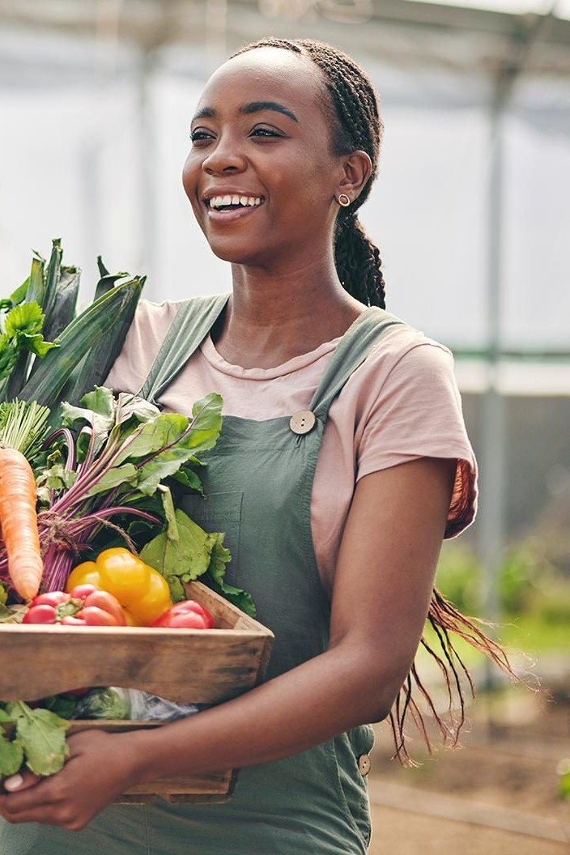

One buyer, one cooperative, one season.
NEXT STEPS AND ASK
Next step
An 8-week pilot: one Nairobi grocer, one Kirinyaga cooperative and a field agent.
Our ask
Introductions to a pilot buyer and cooperative.
Oracle mentorship and OCI credits for production.
Sell before you harvest.
Team Bora Chakula
Live app
Code
Notes:
Time: 0:30. This slide stays up for the 3 minutes of questions, so judges can scan the codes. NEXT STEP: “Our smallest credible next step is an 8-week pilot: one Nairobi grocer, one farmer cooperative in Kirinyaga and one field agent, using the app exactly as it runs today.” ASK: “We’re asking for two things: introductions to a buyer and a cooperative for that pilot, and Oracle mentorship and OCI credits to move from Always Free to production.” CLOSE (pause, then): “Sell before you harvest. The codes take you to the live app and our code. Thank you.” LINKS: Live app — https://gc0208e4d90b947-harvestlinkstrathmore.adb.eu-frankfurt-1.oraclecloudapps.com/ords/r/harvestlink/harvestlink/ (sign-in required; judge login in the submission). Code — https://github.com/Byte-Barn/BoraChakula LIKELY QUESTIONS — short answers: • What if a farmer doesn’t deliver? Matching re-runs automatically; the next-ranked farm fills the gap, and the ledger shows who confirmed. • Farmers without smartphones? A field agent records the farmer’s answer (there is a form for this); SMS and USSD are on the roadmap. • Payments? Not built yet; M-Pesa payouts are on the roadmap. Today the ledger locks in the agreed price and quantity. • Is the blockchain real? Yes — an Oracle Database blockchain table: rows can’t be edited, each is SHA2-512 hash-chained, and we can verify the chain live. • Are the impact numbers real? Each one is tagged live, simulated or demo in the app; demo people and businesses are fictional. • Water and climate (Track 5)? Food that is wasted also wastes the water, fertiliser and fuel used to grow it; selling every grade before harvest protects that investment. • Data privacy? Built for the Kenya Data Protection Act: consent recorded, phone numbers hidden until the farmer accepts, data export and account deletion.

